Slide 1
Process management

Slide 2
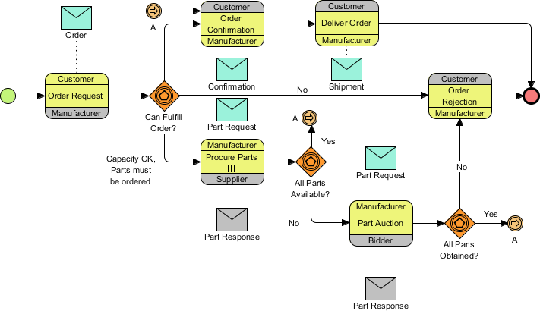
Process
Source: https://www.visual-paradigm.com/tutorials/businessprocessmodeling.jsp

Slide 3
Process management
Origins of the process approach
Functional business orientation vs process orientation
Definitions and process types
Process identification, mapping and modeling

Slide 4
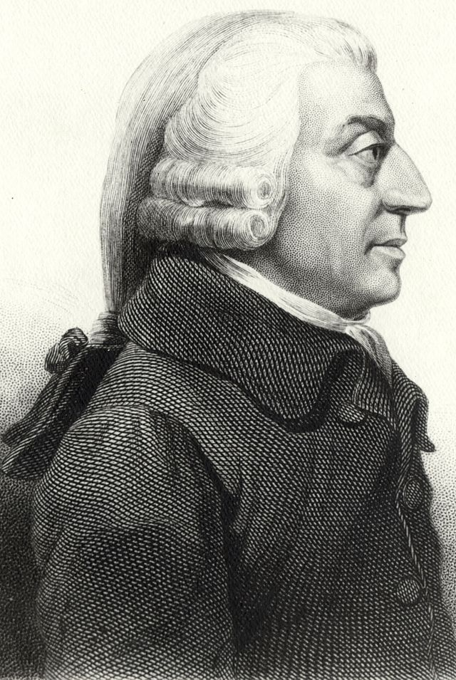
Origins of the process approach

Slide 5
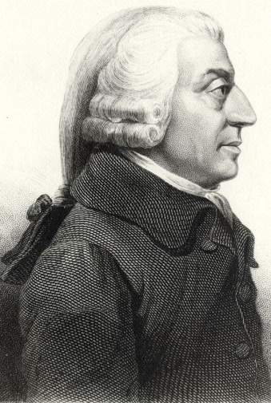
Origins of the process approach
Adam Smith (XVIII c.) – division of labor:
One worker specializes in pulling the wire from the spool; a second worker specializes in sharpening one end of each piece of cut wire into a pin point; a fourth worker specializes in flattening the other ends of the pins into pinheads; and so on.
http://pl.wikipedia.org/wiki/Adam_Smith#mediaviewer/Plik:AdamSmith.jpg

Slide 6
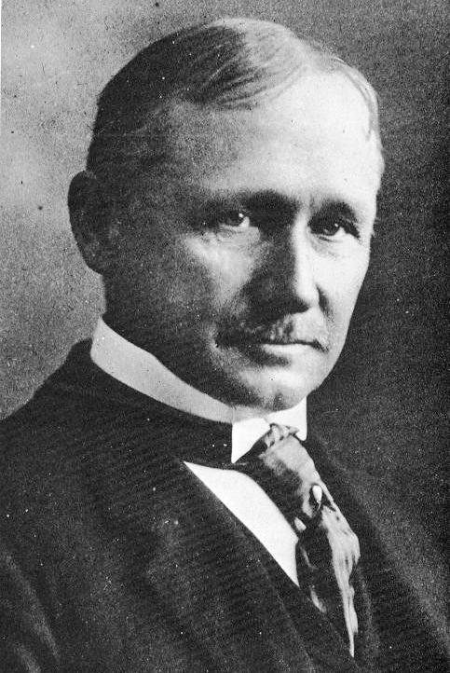
Origins of the process approach

Slide 7
Origins of the process approach
F.W. Taylor (1911) – principles of scientific management
http://en.wikipedia.org/wiki/Frederick_Winslow_Taylor#mediaviewer/File:Frederick_Winslow_Taylor_crop.jpg

Slide 8
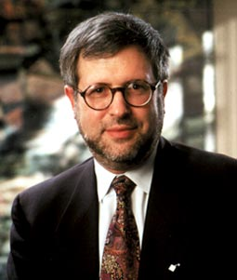

Business Process Reengineering (BPR)
Hammer, Champy „Reengineering the Corporation.
A Manifesto for Business Revolution” (1993)
Reengineering – „starting over from scratch”
http://www.glamspeak.com/fiche.cfm/165168.htm

Slide 9
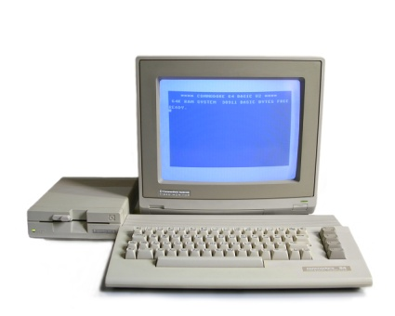
90’s of the 20th century
Computers ☺
Workflow Systems
Document circulation process? Processes in one department ☹
MRP, ERP, DEM ☺
Notes:
Workflow Systems - software used to control production and make its measurements. Because early systems were used in the document circulation process, but only within 1 department, companies such as SAP and Oracle began to create applications that could connect a single process with many other modules. This is how the concept of system-based, often computer-assisted business management focused on optimization was developed. And, as a result, integrated management systems of MPR (Material Resources Planning), ERP (Enterprise Resources Planning) and DEM (Dynamic Enterprise Modeling) class were created.

Slide 10

90’s of the 20th century
Quality ☺
Quality departments
ISO
TQM
J-I-T
Six Sigma
http://m.c.lnkd.licdn.com/mpr/mpr/p/7/005/06b/107/10eb113.jpg
Notes:
Some scientists developed theories about Workflow or BPR, while other researchers were working on improving and controlling the quality of process output elements at that time. Companies began to create quality departments, implement ISO, the concepts of Total Quality Management and Just In Time as well as a statistical approach to measuring quality developed - the Six Sigma methodology.

Slide 11

3rd wave of process management
1st wave: Taylors ideas (20’s of the 20th century.)
2 wave: the concept of BPR supported by IT systems
3 wave: the concept of BPM (Business Process Management)
http://www.rockeyshores.com/construction.html
Notes:
Challenges of globalization - the reason for the creation of the third wave. Mergers, acquisitions, as a result problems with process integration (2 different organizations), with complexity of processes (several factories in different places - a typical problem in the automotive industry). Solutions: standardization of processes, more frequent use of information technologies.

Slide 12
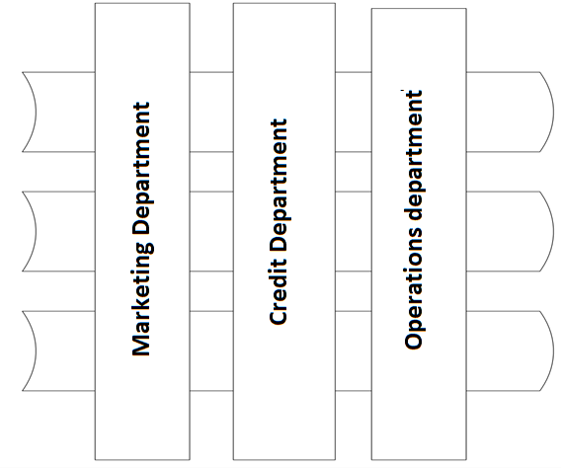
Functional approach
Notes:
A classic approach to organizing your business. Individual workstations are grouped into larger units, and these form departments. The main grouping criterion is the same or similar scope of functions that the elements perform in the enterprise.

Slide 13
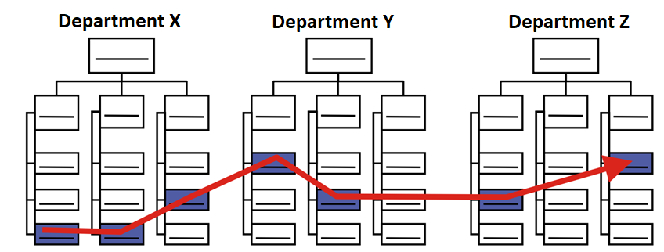
Process approach

Slide 14
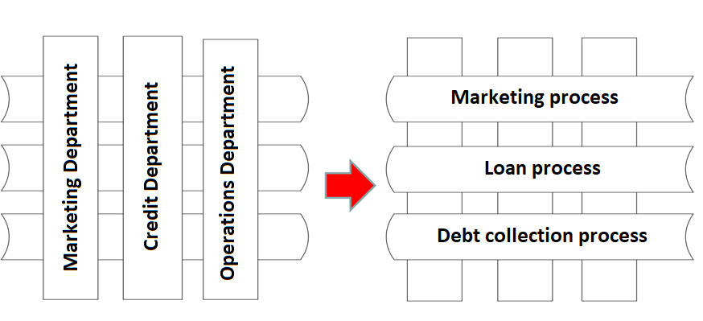
Process approach

Slide 15
Functional approach vs proces approach
Scope | Functional approach | Process approach
Communication channels | Highly stucturized control of information flow | Free flow of information
Operations | Unified opperations with limited scope | Opperational variablity in individual business units
Decision making process | Formal authority | Management by delegation decision-making authority
Adaptability | Gradual adaption to the environment | Need for change in the proces of continous improvement of the organization
Work organization | Formal procedures | Independant design of effective processes
Control | Strict, formalized control | Self-control
Behavior | Behaviors are defined by job descriptions | Roles and responsibilities set by the specifics of the processes
Participation | Limited information, decisions are made top-down | Team work, cooperation between teams
Orders and control
Owners and managers of processes
Perechuda K., Metody zarządzania przedsiębiorstwem. Wydawnictwo AE we Wrocławiu. Wrocław 1999, s. 38

Slide 16

Functional approach vs process approach
Disadvantages of the functional approach ☹:
Complicates task execution
Makes overall optimization difficult
Longer task execution
Reduces elasticity of responsiveness
Increases costs
Focused on static phenomena
Does not focus on dynamic phenomena
http://passionateteaching.files.wordpress.com/2011/07/tug1.jpg

Slide 17

Process approach
Process approach: organization as a set of processes and defining it as a map of relationships and process sequences.
http://sr.photos2.fotosearch.com/bthumb/CSP/CSP629/k6296128.jpg

Slide 18
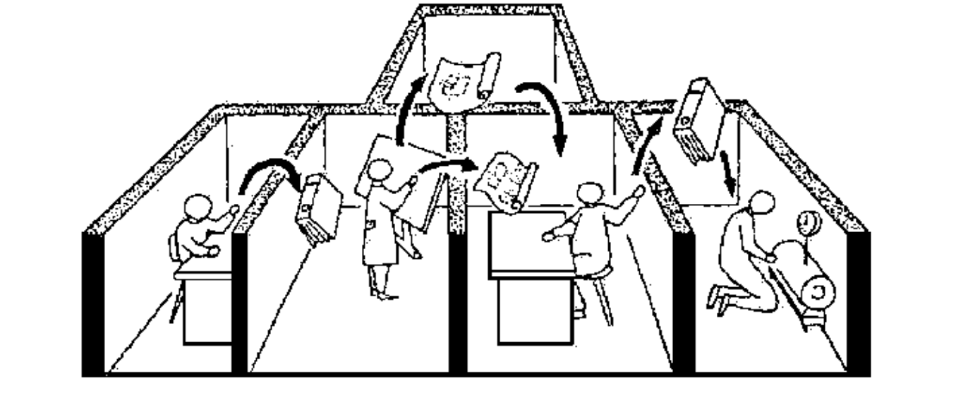
Process approach

Slide 19

Functional approach vs. process approach
Advantages of the process approach
Better understanding of value creation
Cost reduction
Clear definition of goals and responsibilities
More efficient functioning of the organization
(= greater customer satisfaction)
http://images.clipartpanda.com/cooperation-clipart-compliance-clipart.jpg
Notes:
The process approach is based on processes that combine the goals, design, management and control at the level of the entire company with the level of the workplace. Important (compared to previous management approaches): focus on creating added value and customer orientation. Processes define a sequence of sequentially connected activities that merge into a logical whole. The organization is not seen through the prism of departments / departments; its "functionality" is disappearing.

Slide 20

Process approach
Disadvantages of the process approach
Necessity of following strict procedures
While defining processes: many (unproductive) meetings instead of actual implementations
Danger of excessive bureaucracy
Disregard of behavioral factors
http://bobmaconbusiness.com/wp-content/uploads/2014/07/bureaucracy.jpg

Slide 21
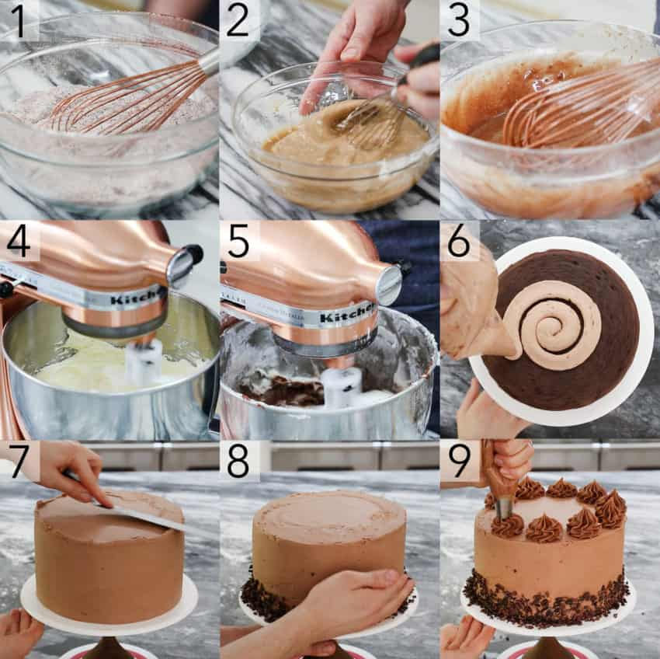
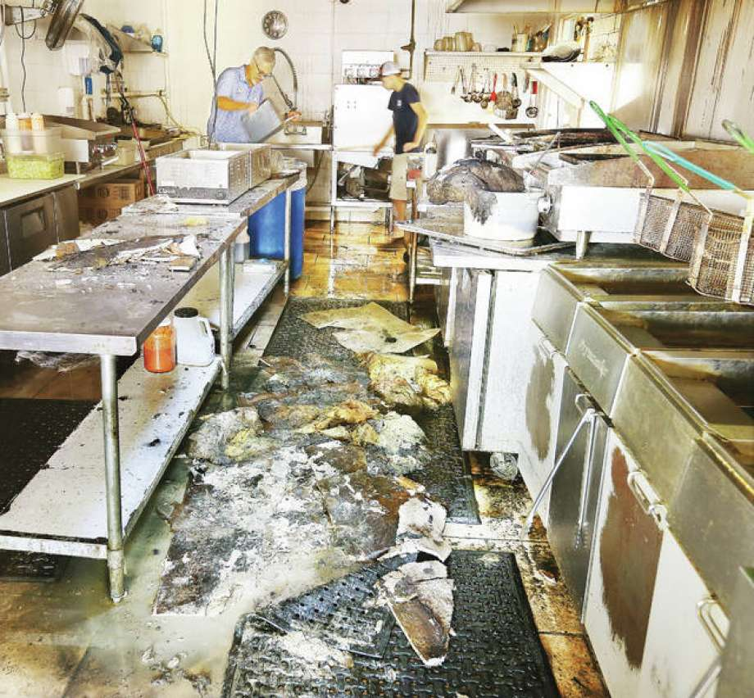
Process as a value chain
By contributing to creation or delivery of the product or service, each subsequent activity should add value to the effect of the previous activity.
Source: https://preppykitchen.com/ultimate-chocolate-cake/, https://www.google.com/search?q=mess+in+the+kitchen&tbm=isch&ved=2ahUKEwjNm6GM9ZzoAhXSapoKHehABbkQ2-cCegQIABAA&oq=mess+&gs_l=img.1.1.35i39l2j0l8.14477.17202..19522...1.0..2.104.1356.18j1......0....1..gws-wiz-img.....10..0i24j35i362i39j0i131j0i67.qPtRXrWv71E&ei=yVluXo2TFNLV6QTogZXICw&rlz=1C1GGRV_enPL751PL751#imgrc=rDT4hhrKHsFRuM
Notes:
Each enterprise has its own individual chain of processes that create value for its clients. Looking at the company through the prism of the processes taking place in it, we go beyond the boundaries of the company. The value chain is a set of activities necessary to design, prepare production, manufacture, market, distribute and service a product. We are interested not only in satisfying the needs and expectations of customers by examining their preferences and creating a specific product, but also as part of after-sales service processes, we can bring additional value to the customer. The value chain cannot be burdened with the costs of non-value-generating activities or an excessive number of support activities (because they unnecessarily increase the price that the customer must pay). The more activities in the process structure that do not add value, the higher the cost the customer must pay in the form of the purchase price of the product.

Slide 22
Process
Process: a collection of related, structured activities or tasks by people or equipment which in a specific sequence produce a service or product (serves a particular business goal) for a particular customer or customers.
Process: a stream of activities transforming …………. into …………..
Notes:
Processes exist and run through the organization regardless of whether they have been previously identified and described. It happens that some processes are not noticed at all.

Slide 23
Process
Process: a collection of related, structured activities or tasks by people or equipment which in a specific sequence produce a service or product (serves a particular business goal) for a particular customer or customers.
Process: a stream of activities transforming inputs into outputs

Slide 24
Process definitions
Author | Definition
M. Hammer, J. Champy | Process – an bundle of activities focused on one or several inputs, as a result of which the customer receives a product of desired value.
M. Manganelli, M.M. Klein | Process – a series of interrelated activities that transform inputs into a process product
J. Brilman | Process – a stream of activities that transform inputs (raw materials or information) provided by suppliers into customer production that includes added value.
A.G.Rummler, A.P. Brache | Process – a value chain. Through contribution in creation or deliviery of a product or service, each subsequent activity in the process should add value to the effect of the previous activity.
M. Trocki | Processes – groups of activities in cause-effect relationships, that are carried out by teams of contractors, to achieve an intended purpose.
K. Perechuda | Process – a set of activities that take place simultaneously, conditionally or sequentially, leading to changes in the company’s input resources into final effects in the form of a ready goods or service.
K. Lisiecka | Process – logical organization of personel, materials, energy and actions into systemized manufacturing activities oriented towards achieving predetermined results.

Slide 25
Business process characteristics
A chain of ……………. actions transforming …………… inputs into …………….. outputs
Main goal: creating added ………. (verified by recipient) included in a definable end result (product / service/ information)
Possesses a supplier and …………….. boundaries are determined by the type of sales or purchase transaction
…………….. = can be recorded in a form that can be read by those carrying out the process

Slide 26
Business process characteristics
A chain of sequential actions transforming measurable inputs into measurable outputs
Main goal: creating added value (verified by recipient) included in a definable end result (product / service/ information)
Possesses a supplier and receiver (client); boundaries are determined by the type of sales or purchase transaction
Repetition = can be recorded in a form that can be read by those carrying out the process

Slide 27

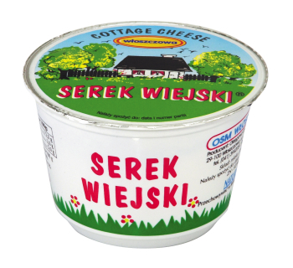


Process
http://media.gorannecin.rs/2010/11/Krava-mleko.jpg, http://czytamyetykiety.pl/wp-content/uploads/2013/09/Serek-wiejski-24668-big.jpg, http://www.school-clipart.com/school_clipart_images/a_smiling_boy_with_glasses_carrying_four_large_books_0521-1005-0821-5711_SMU.jpg, http://www.clipartbest.com/cliparts/MiL/Lgp/MiLLgpqeT.gif

Slide 28
Process types – importance of organizational tasks
Primary processes (activities),
Result in a product (service) sold in the market – the basic products/services that bring in income for the comapny e.g. the production and sales of a product in a manufacturing company or book keeping in an accounting office.
Support processes (activities)
Do not directly create products or services but are necessary to facilitate or assist the execution of operating or management processes. Examples of processes that support operating processes are supply procurements, inventory replenishment, and machine maintenance. Examples of processes that support management processes are administrative, typically associated with finance, accounting, sales, or human resources.

Slide 29
Process types – importance of organizational tasks
Managerial processes - of conceptual nature, the effects of these processes are intangible „service” (such as decision-making and implementation control)
Executive processes - execution of orders (decisions) (e.g. execution of a series of technological operations, plan preparation, invoice issuing, debt collection

Slide 30
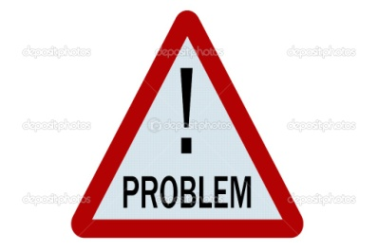
Signs of business process problems
Dissatisfied customers
Some actions are „going not as planned”
Management orders a change of action, but this does not work
Frustrated employees
Rising costs, without clear effects
Increase of bureaucracy
Visible complexibility instead of simplification
Falling profits
Lack of overall control
http://www.swintonfitzwilliam.org/wp-content/uploads/2013/05/depositphotos_6241944-Problem-sign.jpg

Slide 31
Business process problems – case studies
1. The functional manager, who directly controls some of the resources assigned to your project team, demands that you do not speak to his employees directly. Before you assign any task to an employee, he says, you must submit task details in writing to him. If the task is approved, it is sent to the employee by the functional manager. It is impossible to accomplish anything in this work environment, let alone deliver the project on time within a tight budget, considering that even a medium-size project has hundreds of mutually dependent tasks.

Slide 32
Business process problems – case studies
2. In the middle of the project, the line manager pulls out her resources and reassigns them to another project, leaving you out in the cold.

Slide 33
Business process problems – case studies
3. Your own boss, following a “gut feeling,” promises the client delivery of a part of your project within a month, while the carefully developed schedule indicates a true period of three months. No additional resources or budget are available.

Slide 34
Business process problems – case studies
4. Some of your team members believe that the project manager is merely an administrator, serving the basic function of a “team secretary.” They grudgingly accept assignments from you, saying they will do it on their own schedule and let you know when it is done, the project schedule notwithstanding.

Slide 35
Business process problems – case studies
5. Your business clients are in the habit of bringing new scope change requests directly to your team members in order to “reduce bureaucracy.” You only become aware of this when you discover unplanned activities, resulting in schedule delay and extra costs, which are not covered by the project schedule and budget and are incompatible with other elements of the project.

Slide 36
Business process management /process approach
Business process management – focusing on the sequences of actions taken in the enterprise and beyond and the relationships between them to achieve an intended result.
Process approach – systematic identification and management of processes occuring within the organization and particularly the interactions between such processes.

Slide 37

Goal of process management
Basic goals: improving effectiveness and efficiency of processes to meet clients’ needs in the best possible way
Intermediary goals:
Process identification, analysis, design and optimization
Managing processes in consideration with strategic and operational goals for the organization and expectations of clients.
Important - a holistic approach.
Source: http://www.gilaberttax.com/2013/04/16/targeted-partnership-tax-allocations/

Slide 38
Nowosielski’s process maturity model
Level 6: Process management
Level 5: Systematic process improvement
Level 4: Process planning and controling
Level 3: Process measurement and recording
Level 2: Process identification and documentation
Level 1: Process necessity awareness
Level 0: Lack of process awareness
Notes:
Professor Stanisław Nowosielski from Wrocław, Poland.

Slide 39
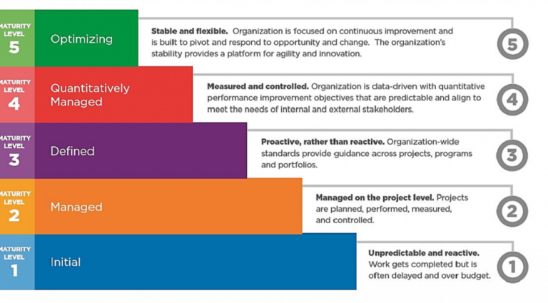
CMMI (Capability Maturity Model Integration) Model
Notes:
The CMMI (Capability Maturity Model Integration) model was developed at Carnegie Mellon University in 2002 as the successor to the CMM (Capability Maturity Model) model, which was created in the late 1980s. CMM mainly referred to software development processes, while CMMI provides a broader view that covers the context of the organization and the maturity of processes occurring in it

Slide 40
Process decomposition
Functional decompostion:
Level 1: distinguishing/isolating functional areas of company
Example: typical manufacturing company:
Marketing and sales
Production and distribution
Material procurement
Financial accounting
Human resources management
Overall company management
Notes:
Functional decomposition - it is practically suitable for everything, but it can be deceptive in its simplicity. People can decompose the processes differently, as a result several hundred process maps can be created in one company, and it would be difficult to put them together into a meaningful whole.

Slide 41
Process decomposition
Level 2: distinguishing process groups
Example: production and distribution:
Production planning and raw material procurement
Processing of raw materials
Product delivery

Slide 42
Process decomposition
Level 3: establishing elementary processes within process groups
Example: transforming materials into products:
Production scheduling
Raw material acquisition
Product manufacturing
Product packaging
Product storing
Preparing products for delivery

Slide 43
Test: Business process characteristics
A chain of ……………. actions transforming …………… inputs into …………….. outputs
Main goal: creating added ………. (verified by recipient) included in a definable end result (product / service/ information)
Possesses a supplier and …………….. boundaries are determined by the type of sales or purchase transaction
…………….. = can be recorded in a form that can be read by those carrying out the process

Slide 44
Test: Business process characteristics
A chain of sequential actions transforming measurable inputs into measurable outputs
Main goal: creating added value (verified by recipient) included in a definable end result (product / service/ information)
Possesses a supplier and receiver (client); boundaries are determined by the type of sales or purchase transaction
Repetition = can be recorded in a form that can be read by those carrying out the process

Slide 45
Process modeling
Process visualization techniques (examples):
Process map
Process card
Chronological process table
Organization relationship diagram

Slide 46
Process mapping
Process mapping:
graphic representation of the functioning of a process or a set of processes/operations and their relationships.
Notes:
The most common technique for visualizing business processes. Appropriate graphic symbols are used to describe individual elements of the process map.

Slide 47
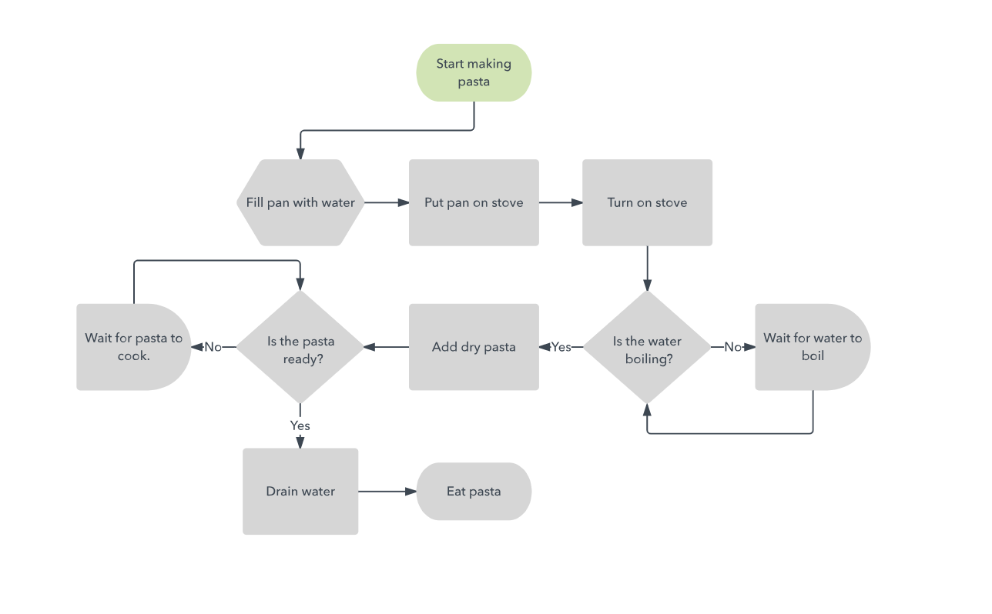
Process mapping

Slide 48
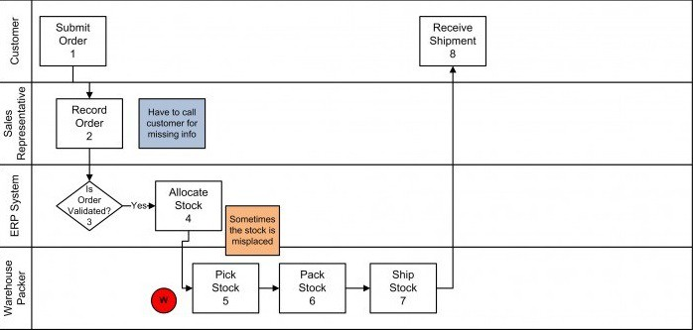
Process mapping

Slide 49
Benefits of mapping
A user-friendly way of describing a process – allows better understanding of the process both by experts and bystanders
The symbols used in process maps are the same in many countries, which enables communication between organizations from all over the world.
Identification of key operations in a given process and determination of inputs and outputs in a given operation
Enables identification of superfluous operations (ones that do not add value) such as storage of semi-processed goods in between operations, internal transport, etc. and problematic areas.
Notes:
In general: it allows you to understand how a given company works. Creating a map begins with the identification of process participants from the organizational units involved, then a description of the process from its start to obtaining the final product is made. The map illustrates not only individual activities in the process, but also the moments of decision making and their variants. After preparing the process map, the current state is analyzed. You can see critical points, bottlenecks, repetitive and redundant activities. The answers to the questions are sought: what information make up the process? In what order are the activities carried out? How long does each operation take? Then, process improvements are sought, and then a map is created that represents the desired state. Few companies have decent process maps, and even fewer employees are aware of them. Each employee knows "something", the higher in the hierarchy the less knowledge of details. In other words, knowledge about the current state of the company exists in a way collectively, fragmented to the minds of many employees.

Slide 50
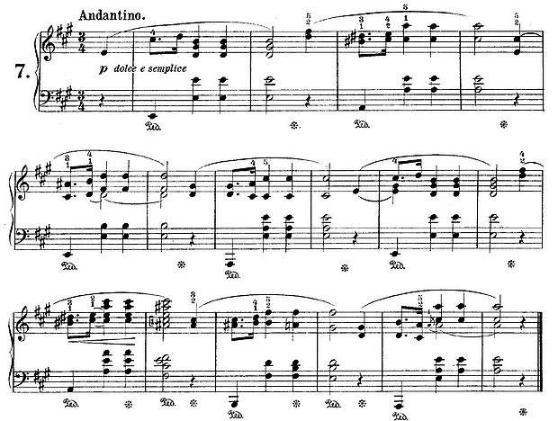
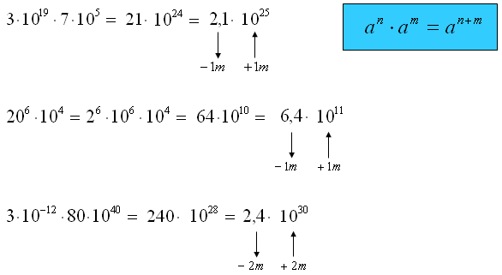
Notation
Notation – a way (system, language) of modeling (processes)
http://matfiz24.pl/wp-content/uploads/2014/07/notacja_wykladnicza_003.png
Notes:
There are many techniques and ways to map processes. The method (system, language) of modeling is called NOTATION. There are many graphic symbols describing individual elements in the process map. Depending on the specifics of the given organization in which the process map is used, various symbols can be found (e.g. the car industry usually uses slightly different symbols than the IT industry).

Slide 51
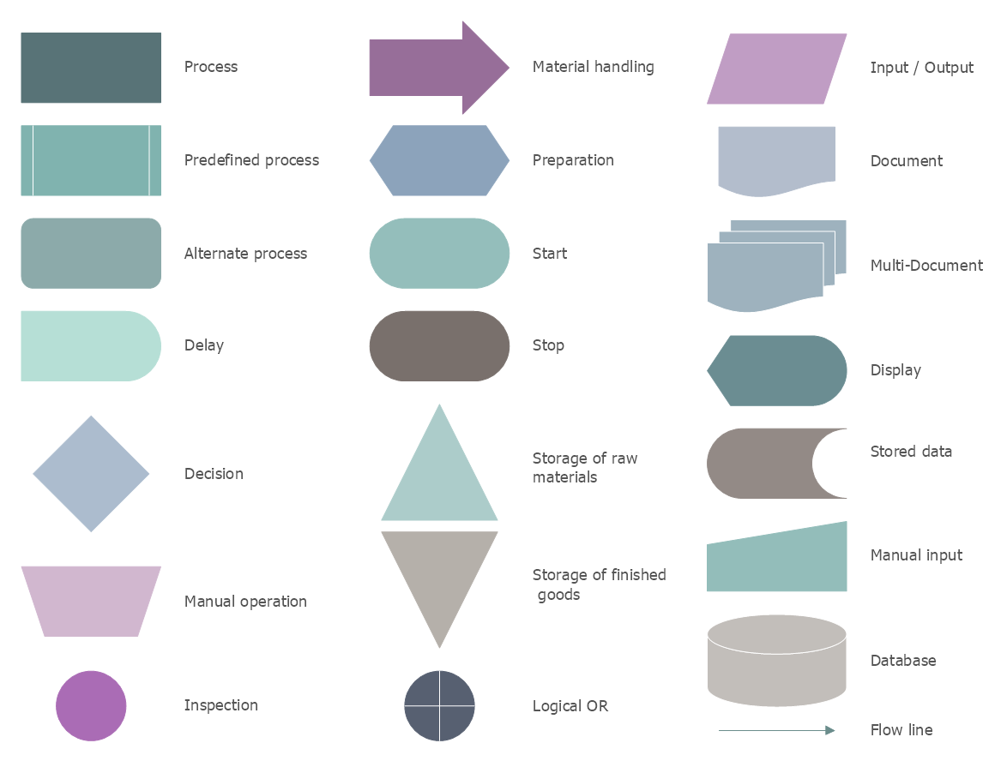
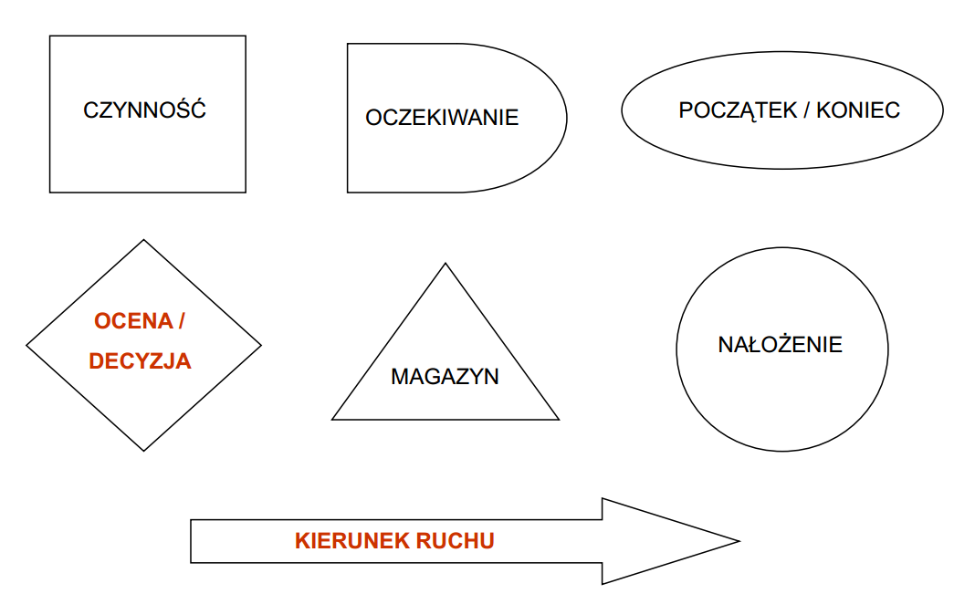
Process mapping symbols

Slide 52
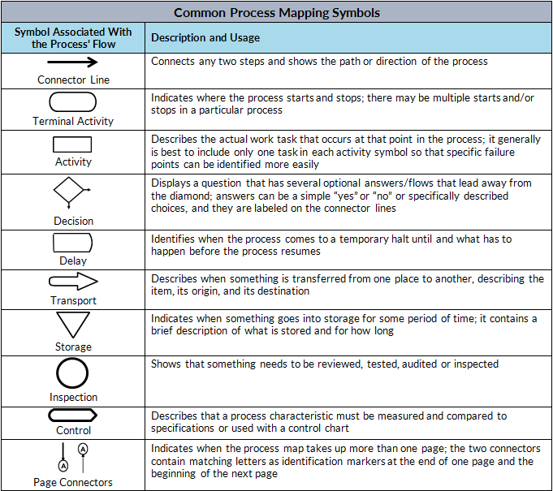
Examples of process mapping symbols

Slide 53
Mapping rules
Rule of conditionality: IF-THEN!
Notes:
The most important rule in mapping seems to be the IF-THEN rule. Shows event CONDITIONALITY.

Slide 54
Mapping and what next?
Problem identification?
Yes ☺
Measurable assessment and monitoring?
No ☹
Important: defining measurable process efficiency criteria ☺

Slide 55
Expected effects of process modeling
Eliminating activities that do not add value to the process
Eliminating repetitive activities at various stages of the process
Introducing activities that improve the quality of effects results, customer satisfaction and improve communication between the participants of the process
Introducing control activities in order to eliminatee duplication of errors in subsequent stages of the process
Savings resulting from reducing employee involvement in activities of the process, reducing other costs, etc.
EFFECTS translate into greater sales and customer retention

Slide 56
Process characteristics
Every identified process can be described by several characteristics:
name
goal
structure
inputs and outputs
supplier and client
attributes
assessment criteria
Additionally it is recommended to indicate the person responsible for the execution of the process, a so-called process owner.
Notes:
Structure: identifies people involved in the process, usually the process team and the process owner.

Slide 57
Process attributes (parameters)
Duration (average duration of all activities in the process)
Timeliness of implementation (time planned vs real time of the process)
Quality (a measure of customer satisfaction associated with the product)
Cost (costs of activities in the process)

Slide 58
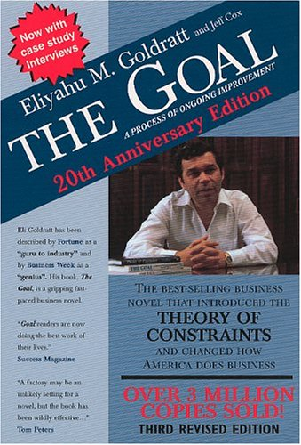

Theory of Constraints
Enterprise – a set of sequentially related units that transform various resources into ready goods
The whole process depends on the weakest link in the organization – the „bottleneck”
Either we manage constraints or they manage us.
Eliayahu M. Goldratt
Notes:
The whole process depends on the weakest link in the organization. According to this assumption, the company is treated as a system of sequentially related units, leading to the transformation of resources into finished products.
The system’s "strength" is determined by the weakest link called the "bottleneck". To improve the overall system, one has to identify such a bottleneck and concentrate all efforts on strengthening or eliminating it. This process is endless, because after removing the old bottleneck, new ones may appear.

Slide 59
Constraint theory - procedures
Identifying a bottleneck
Deciding how to use the bottleneck
Subordinating all other activities to decisions made in the second stage
Eliminating the bottleneck
If the bottleneck has been successfully removed, the procedure should be restarted in order to find a new bottleneck
Notes:
The basic procedure in the theory of constraints, leading to increased productivity, consists of five stages.

Slide 60
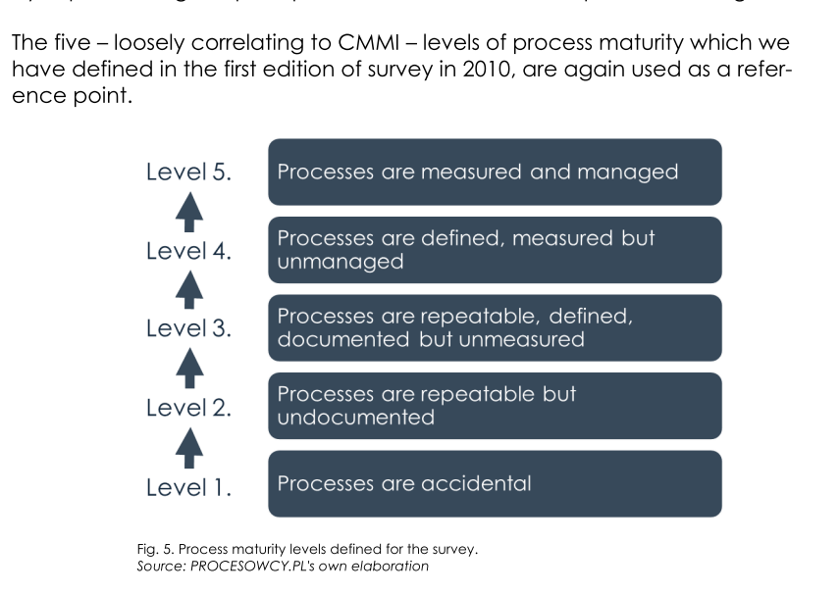

Slide 61
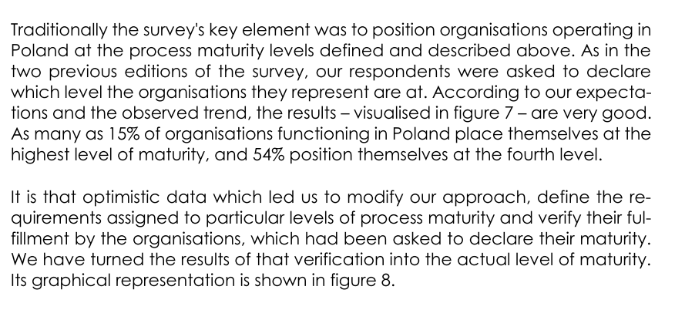

Slide 62
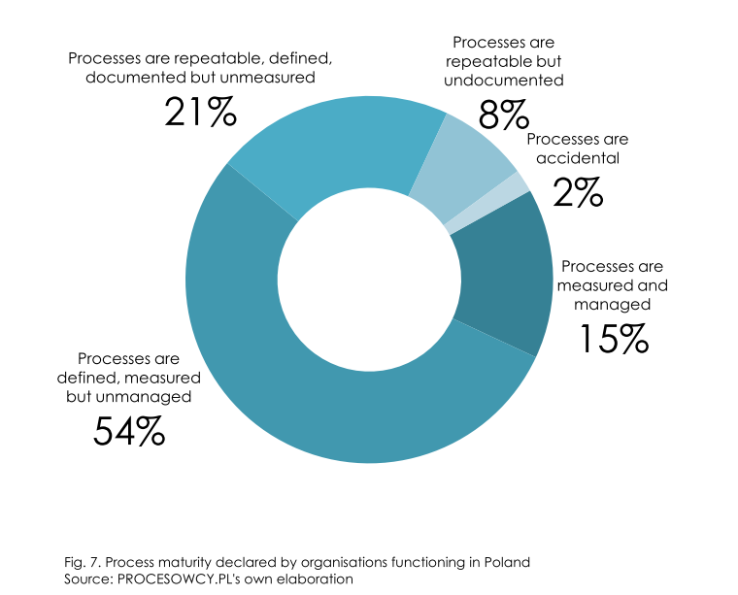

Slide 63
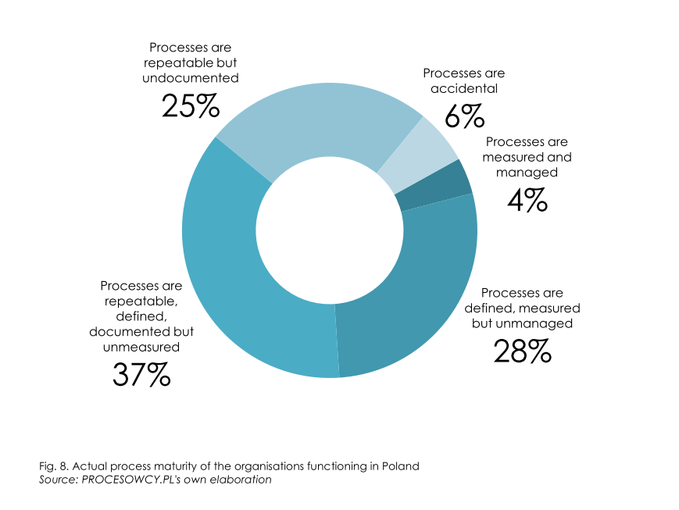

Slide 64
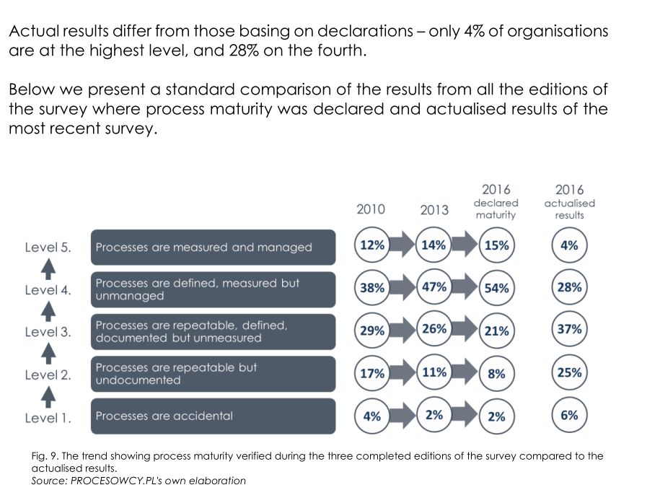

Slide 65
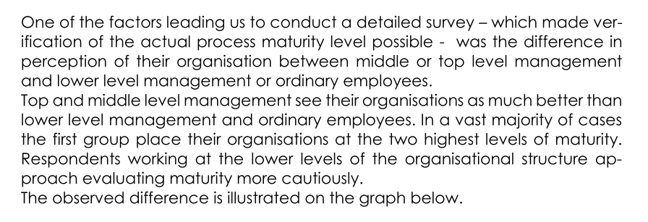

Slide 66
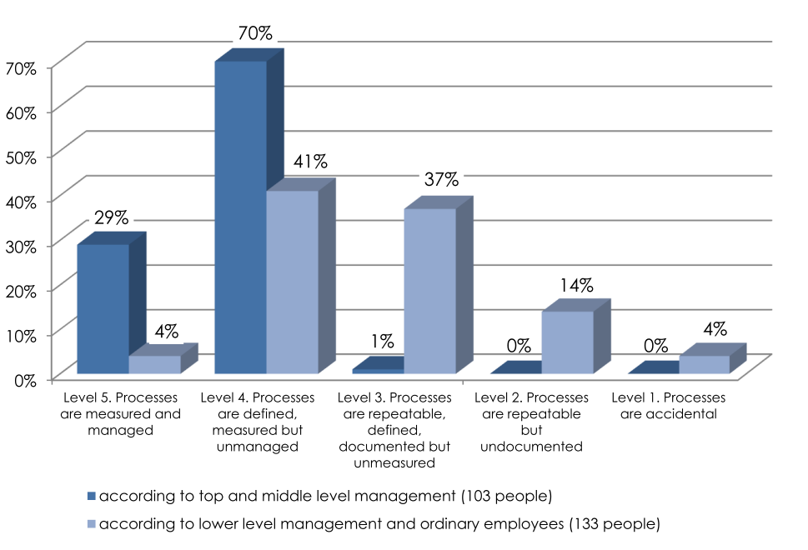

Slide 67
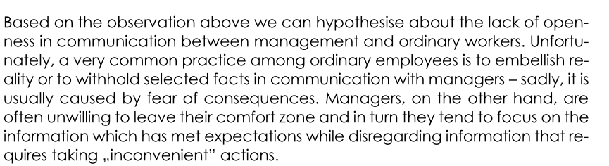

Slide 68
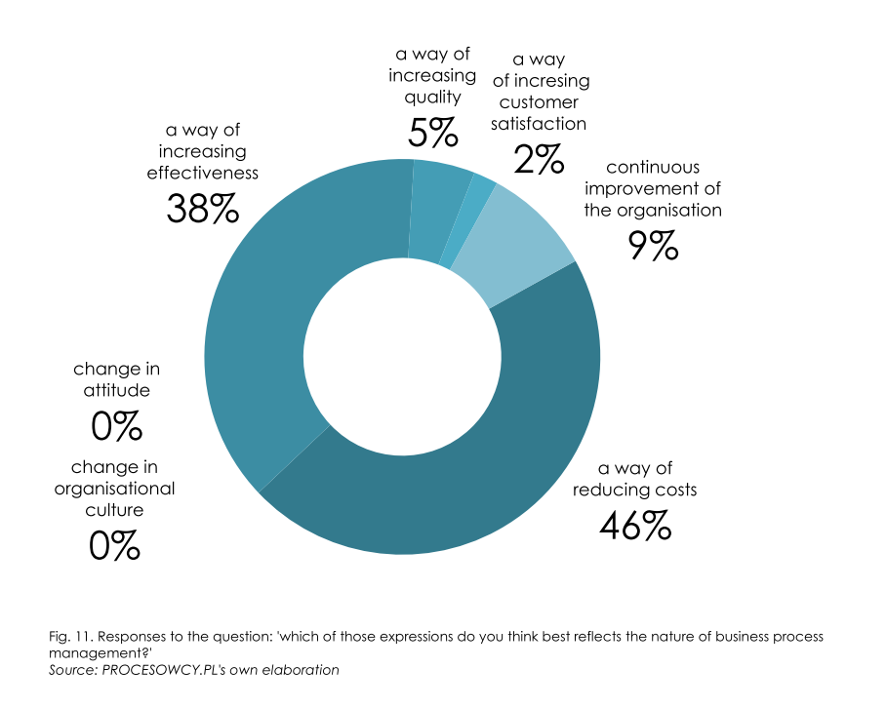

Slide 69
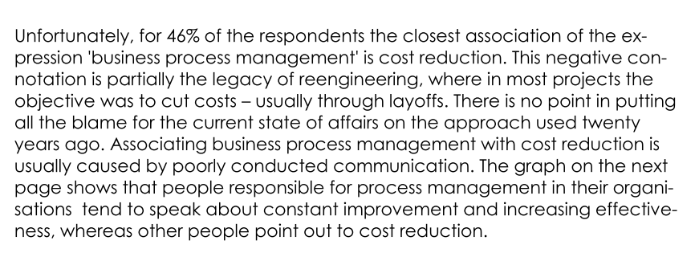

Slide 70
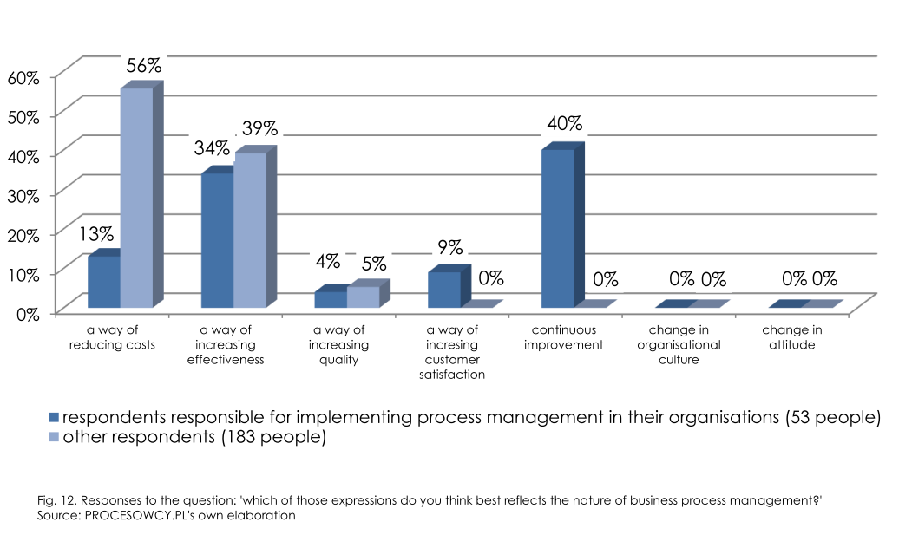

Slide 71
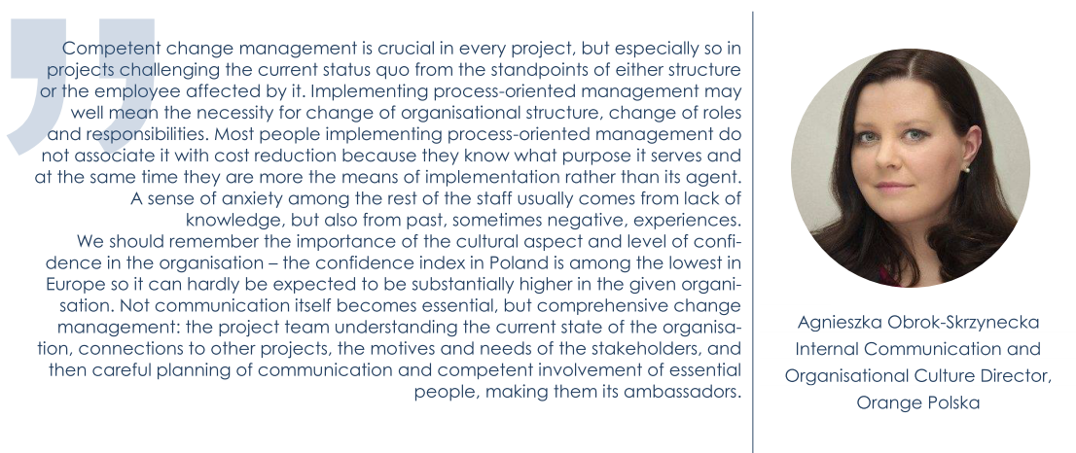

Slide 72
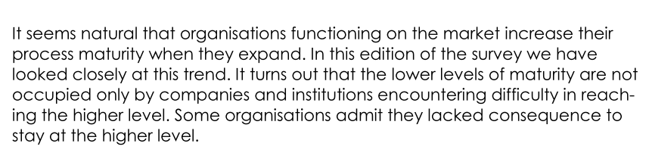

Slide 73
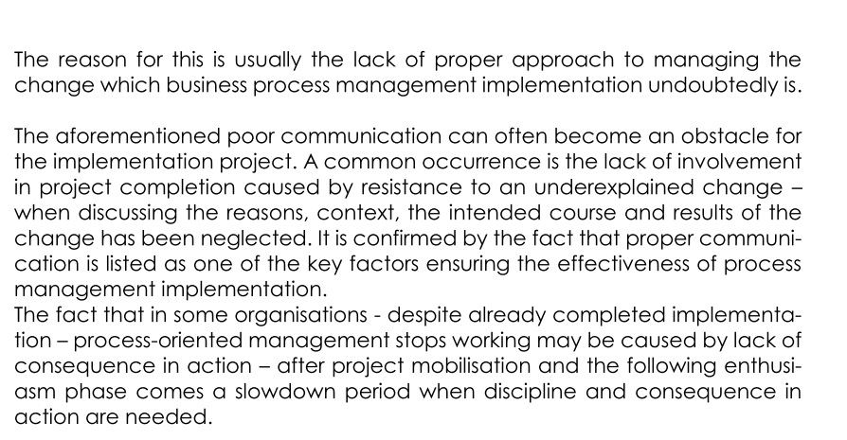

Slide 74
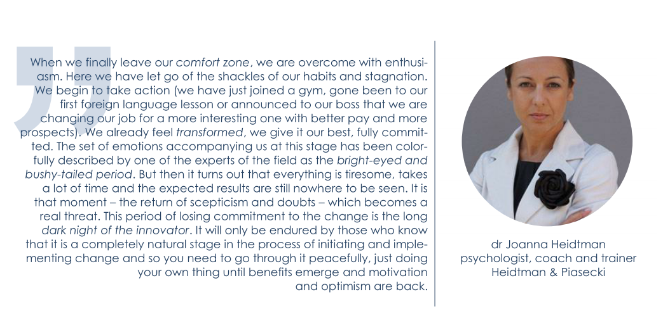

Slide 75
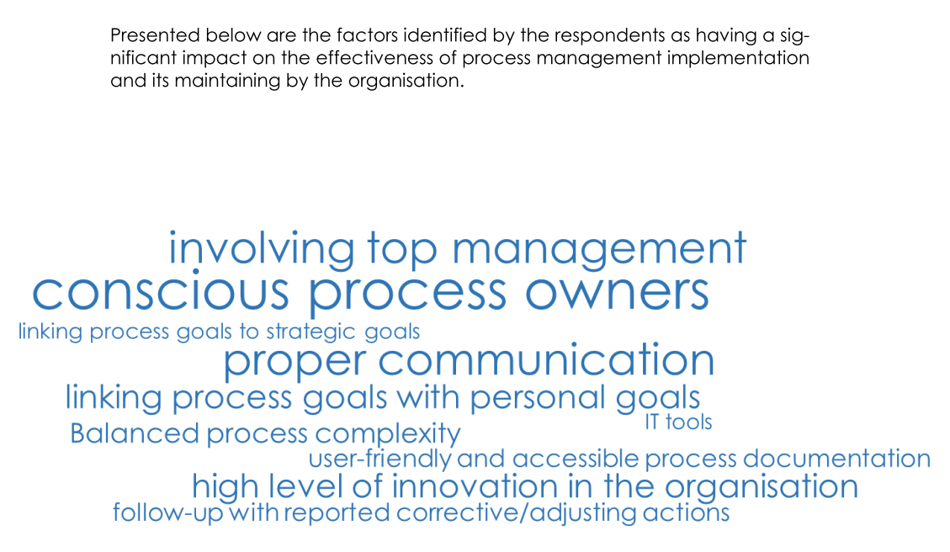

Slide 76
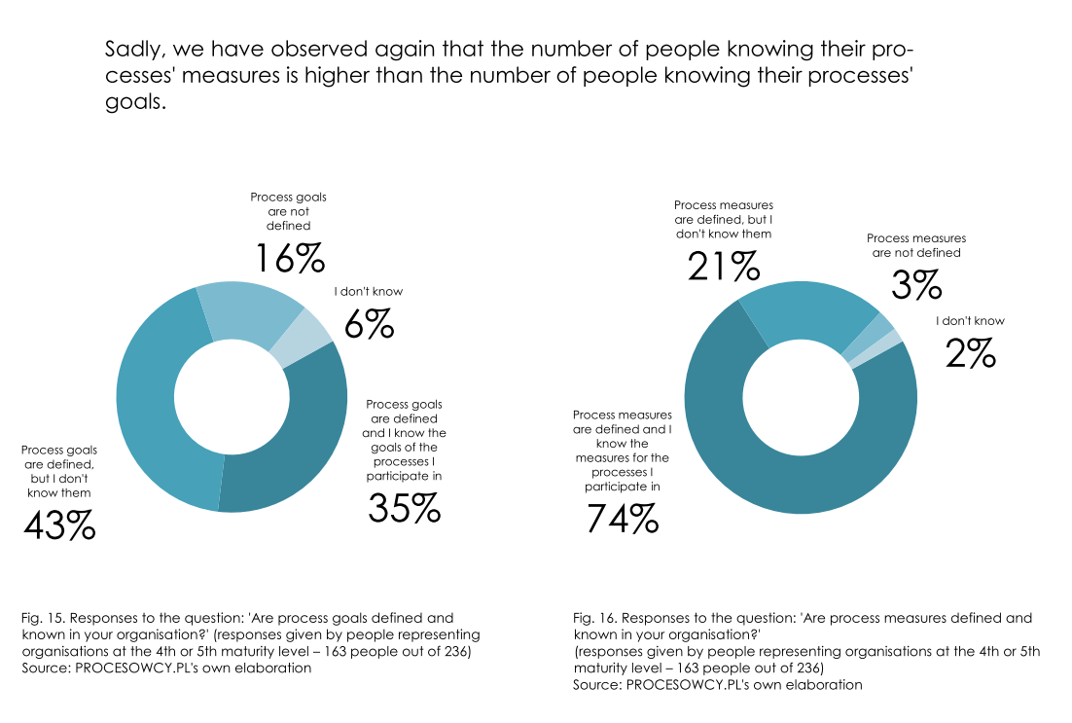

Slide 77
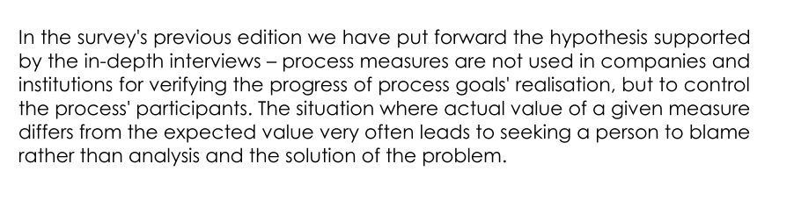
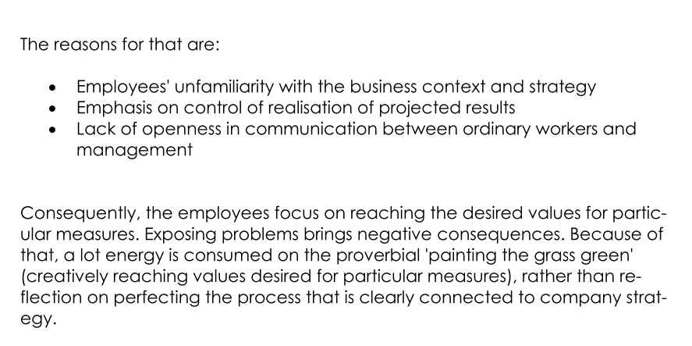

Slide 78
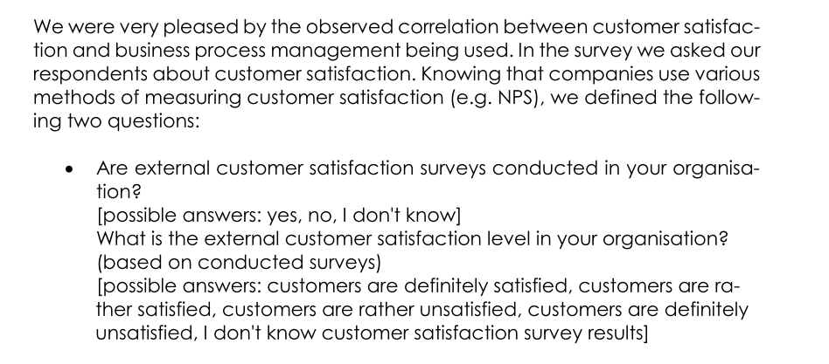

Slide 79
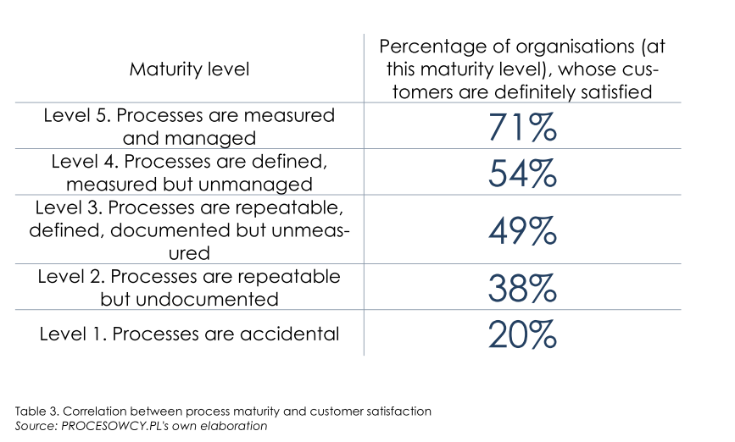

Slide 80
Process characteristics – case study ☺
Characteristics | Description
Name
Goal
Inputs
Outputs
Suppliers
Client(s)
Owner
Assessment criteria

Slide 81
Process characteristics – case study ☺
Characteristics | Description
Name | Making the „pleśniak” cake
Goal | Making the family happy; gaining additional time during quarantine to read work emails in peace
Inputs | Order placed by Dad (Husband) and the Kids
Outputs | Passing on the information ("plates with portions of pleśniak are waiting")
Suppliers | Mom (bought fresh eggs at the market), Dad (bought flour, butter, blackcurrant jam, cocoa, salt, potato flour and sugar online)
Client(s) | Dad (Husband) and the Kids
Owner | Mom
Assessment criteria | The time interval between receipt of the order (at breakfast) and its completion (tea time). Keeping withing the budget limits.

